Slide 1
2025 Employee Benefits
Product Portfolio

Slide 2
New Logo, New Website same URL: https://vaceinsurance.com/

Slide 3
Dental & Vision
Chamber members can work with their broker or self-enroll to begin sponsoring dental and/or vision benefits
3 simple steps to enroll:
Complete VACE+ Group Joinder
Submit enrollment forms for each employees electing dental and/or vision
Mail a check for first month’s premium
NEDD will provide guidance and support as needed
Employers can use NEDDs Group Admin Portal to make eligibility and enrollment updates
Employers can choose to receive their invoice electronically via the eBilling portal.
Payments are made monthly to NEDD via check, eBilling portal, ACH/Electronic Automatic payment
Renewals will be sent to Employers by NEDD in late October/early November
No new ACH form needed if already submitted.
No need to re-register on eBilling or GAP if already registered.
Must be a member of your local chamber to continue on the plan(s).
Plan(s) will automatically renew with your January payment. No need to do anything to renew.
Open Enrollment changes due by 12/16/24
Enrollment Tier | 2025 Dental Premiums | 2025 Vision Premium
Single | $52.44 | $10.53
2-Person | $100.39 | $18.08
Family | $181.34 | $32.35
Kami Cunningham
kcunningham@nedelta.com
https://vaceinsurance.com/

Slide 4
New Employee Benefits for Chamber Members
Worksite Benefits
Life Insurance (Term & Whole)
Accident Insurance
Critical Illness Insurance
Short Term Disability Insurance
Pet Insurance
Access to 15% discount off market rates
Notes:
Simple, Access, Flexibility

Slide 5
Worksite Benefits
Affordable coverage for the employee
Flexible and easy implementation & administration for the Employer
Helps employees achieve financial security and save money on health care expenses
Premiums are fixed at the time they are purchased, do not increase every year
Policies are portable; employees can keep their benefits if they leave the workplace
Employees can choose the benefits that best suit their individual needs and circumstances
Available to employers with 3 or more employees (business owner count as an employee)
Part time employees working at least 20 hrs. per week are eligible
Employers can contribute all, some or none of the premium
Easy to implement with or without a broker
Initial and ongoing enrollment support through VACE+ partner, csOne Benefit Solutions
Improves employee health and wellbeing, satisfaction and engagement

Slide 6
Initial & Ongoing Enrollment Support with csOne Benefit Solutions
Chamber Member / Employer
Decides to offer Voluntary Benefits
Contacts broker and/or csOne Benefit Solutions
Meets with employer to outline enrollment strategy & timeline
Meets with employees to review benefit options & calculate monthly premiums
Provides employer with payroll deduction report
Meets with employer to review first invoice
Receives group and enrollment information from csOne Benefit Solutions
Sends post-enrollment materials to employees
Invoices Employer
Pays out benefits
Works with employees to collect premium if they leave employment

Slide 7
Life Insurance – Term & Whole
10, 15, 20 or 30-year Term Life Insurance (depending on age)
Death benefits range from $25,000 - $75,000
Option to purchase $10,000 policy on spouse
Premiums determined based on employees age and smoker status
Whole Life Insurance (guaranteed issue for employee)
Death benefits up to $200,000 for employees age 50 or younger (maximum death benefit $75,000 for employees age 51-80)
Option to purchase policies on spouse and children
Policy amounts vary based on employee’s policy amount
Notes:
This can be a 10, 15, 20, or 30 year term depending on EE age. For Term, the GI is only available to groups of 50+ eligible with 20% participation.

Slide 8
Accident Insurance
Helps offset unexpected medical expenses that can result from an accident or injury
Cash payout to the employee
Option to purchase Accident insurance to cover employee's spouse and/or children
Guaranteed issue
Can include $50 reward for getting an annual physical
Rewards pays for 1/3 of the employee-only premium on a Basic plan

Slide 9
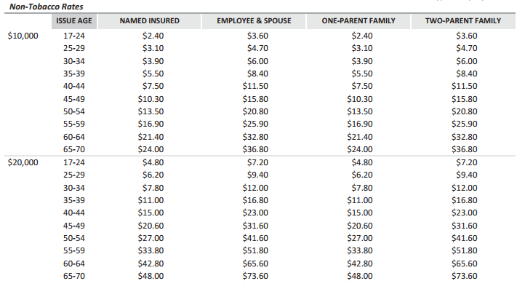
Critical Illness Insurance
Pays a lump-sum benefit following a critical illness diagnosis
Up to $20,000 in coverage available
Option to purchase $10,000 in coverage on spouse

Slide 10
Short Term Disability Insurance
Policy to replace a portion of an employee’s income if they become unable to work due to accident or illness
Pays up to 60% of weekly income up to max of $4,000 per month
Benefit duration periods of 6, 12 & 24 months
Waiting period options: 0/7, 7/7, 0/14, 0/30, 30/30, 60/60, 90/90, 180/180
Premiums are based on employer’s industry risk classification and employee’s age
(accident/illness)
Example Employee | Electric/Gas/Power Utility - 30 years old | Computer Programming/Consulting - 30 years old
Hourly Rate / Annual Salary | $25 per hour/40 hours per week | $85,000 per year
Benefit | $2600 monthly benefit No waiting period for accident, 14-day waiting period for illness, 6-month benefit duration | $4200 monthly benefit 14 day waiting period for accident & illness, 6-month benefit duration
Premium | $87.10 per month | $94.51 per month

Slide 11
Pet Insurance
Each Chamber has a unique URL
Chamber members can access the Pin Paws discount by clicking on their chamber’s URL
Exclusive chamber discount of 15% off market price
Employees self-pay; no need for payroll deduction
70% of US households own a pet
14% of Gen Z
32% of Millennials
24% of Gen X
27% Baby Boomers

Slide 12
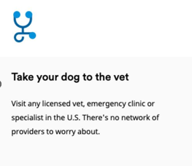
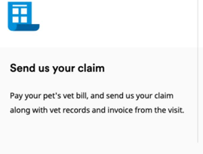
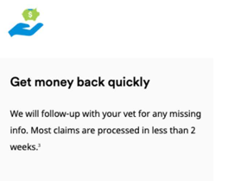
WHAT MAKES PIN PAWS PET CARE DIFFERENT FROM OTHER PET INSURANCE COMPANIES?
Coverage for Cats and Dogs of All Ages & Breeds³ No Initial Exam/Past Vet Notes Required Accident Coverage Starts at Midnight Customizable Deductible and Out-of-Pocket Max Annual Max Payouts as Opposed to Per Incident Choose Your Reimbursement Percentage Multiple Value-Added Benefits Included
Routine Care Option Available with Customized Plans⁵ Available in All 50 States
Powered by
PIN
PAWS
Pet Care

Slide 13
PLAN OPTIONS & COVERAGE DETAILS
PIN
PAWS
Pet Care
PLAN OPTIONS
ANNUAL BENEFIT | DEDUCTIBLE | REIMBURSEMENT | ROUTINE CARE
$2,000 | $50 | 70% | NONE
$5,000 | $100 | 80% | $125
$10,000 | $250 | 90% | $250
- | $500 | - | $400
- | - | - | $575
 |  |  | Standard Wellness*
PIN PAWS PLUS BENEFITS ALSO INCLUDED
PLAN PRICING
COVERAGE DATES
Starting at
$19
▸ Variable pricing based on:
▸ Accidents Covered at Midnight
/ mo
▸ Breed, Age, Zip Code
▸ 14-Day Waiting Period on Illness
*Not available in all states. Availability based on member state.

Slide 14
2025 Open Enrollment & Next Steps
VACE+ website going live soon!
New Colonial Life Worksite Benefits can be effective as early as 11/1/24
Pet Insurance available for purchase beginning 11/1/24
NEDD to send Employers Dental renewals in late October/early November
Group-sponsored plans will passively renew
No change to vision premiums; entering year 3 of 4-year guarantee
Open Enrollment changes for dental and vision to be submitted by 12/1 for best chance at being reflected on the January invoice
Changes received after 12/1 will be reflected on February invoice
Last date to submit open enrollment changes: December 16th

Slide 15
Questions?
https://vaceinsurance.com/

